Slide 1
15. Campaigns & Elections
Breakout Sessions
POLS 1101
12:40pm-1:30pm Park Hall 145
& 1:50pm-2:40pm Leconte Hall 135
SIYUAN (Siri) ZHAO
Siri.Zhao@uga.edu

Slide 2
Nomination
Nomination mostly happens within the party (not given by party leaders).
Nomination for Congress and state offices
  Primary election – highly decentralized; competition tends to decline.
    Closed primaries: voters must declare a party affiliation before voting the nominees
    Open primaries: voters needn’t declare a party affiliation
    Modified closed primaries: allowing individual state parties to decide who can vote
    Modified open primaries: entitling independents to vote in a party’s primary
  Placing the nomination of party candidates in the hands of voters (even not party members) contributes to the pluralist democracy.
    However, why hasn’t decentralization brought about more competition?
Characteristics | Open Primary (State A) | Closed Primary (State B)
Voter Eligibility | Any registered voter can participate | Only registered party members can vote
Role of National Party | Weak | Strong
Opportunity for New Candidates | High | Low
Party Unity | Low | High
Voter Influence | Broad but dispersed | Limited but concentrated
Notes:
Invisible primary (agreement within elites)
Resources network controlled by the party organization
Individual level: require the candidate to be resourceful; voters are a predictable small group – core subgroup in a party, so there can be few voices in the nomination stage.

Slide 3
Nomination (cont`d)
Nomination for President
  After the chaotic 1968 Democratic National Convention — where party leaders chose the nominee (Hubert Humphrey) without most primary voters having a say,
  After 1972, the presidential nomination process shifted from party-centered to voter-centered. Is this a democratic improvement or a loss of institutional stability?
    E.g. Consider: can party-controlled nominations protect democracy by filtering out extremist candidates? Do you think it is good, or bad?
    By definition it’s a “party nomination”, so who should play a more important role, ordinary party members, or the party convention / caucus?
Before 1972 | After 1972
Party elites controlled delegates and convention outcomes | Candidates compete directly in primaries and caucuses
National conventions chose nominees | National conventions now confirm nominees already chosen through primaries
Party organization raised and distributed funds | Candidates build their own fundraising networks (e.g., PACs, small donors)
Party loyalty and hierarchy dominated | Media exposure, personal image, and campaign strategy dominate
Notes:
Betrayal of democracy

Slide 4
Nomination (cont`d)
Nomination for President
  How do the state parties select delegates to their national conventions?
    Presidential primary: proportional / winner-take-tall; mainstream method
    (local) caucus / (state) convention
    To gain popular attention, states practice front-loading strategies.
  Campaigning for the nomination
    First “TESTS” in Iowa (party caucuses) and New Hampshire (primary)
      Given that Iowa and New Hampshire are less demographically representative of the U.S. population (mainly white & rural), thus bearing the risk of undermining democratic representation, why could this happen in past decades? If you could redesign the nomination calendar, which states would you put first?
      Path Dependence, “Lock-in” Effect, vested interests
    Campaigning results in several consequences / fun facts
      No incumbent president seeking for reelection -> fierce competition in both parties
        Dispersed / fragmented resources, discourses, powers, …
      An incumbent president can usually be renominated within the party
      In the nonincumbent party, numerous hopefuls seek the presidential nomination

Slide 5
Presidential Elections
A president is elected not in a national election, but in a federal election.
  Interesting for me! The key to win a presidential election lies in the state level, not the individual level, which shows differences between unitary and federal system.
The electoral college
  538 electoral votes: one vote for each Congress member + the District of Columbia
  Each state selects their electors through popular vote.
  From “independent” to “pledged” electors – party dominates!
    Chiafalo v. Washington (2020): States can require electors to follow the popular vote.
  Why should we have the electoral votes system?
    The federal form of government
    Balancing candidates’ attention between large and small states, urban and rural areas, people of different SES; avoiding being captured by a few easily accessible groups
    Lower administrative cost: potential risk of a nationwide recount in a close election
    Are these ideas convincing enough for you? Should we (attention: not “Do we”) continue to have the electoral votes system? Why or why not?

Slide 6
Congressional Elections
General election (presidential election; congressional / midterm / off-year elections)
Party affiliation now dominates, but it was NOT this way.
  Straight ticket: Voting for a single party’s candidates for all the offices.
  Split ticket: Voting for candidates from different parties for different offices.
  Split-ticket voting suggests that voters may trust different parties for different levels of government. Does it make sense, or seem ridiculous to you?
There can be sizable discrepancies between votes won and seats won.
  First-past-the-post elections: elections conducted in single-member districts that award victory to the candidate with the most votes. (no need to be more than 50%; relative majority, not absolute majority)
  Extreme example: a party got 45% of the votes in all the districts, where it was always the one with the most votes, then it could get all (100%) the seats.
  If you could redesign the congressional election system, would you keep the single-member, first-past-the-post model or replace it with proportional representation? Why?

Slide 7
Campaigns
Goals of an election campaign
  Acquiring and analyzing information about voters’ interests (via opinion polls)
  Developing a strategy and corresponding tactics to appeal to these interests
  Delivering the candidate’s message to the voters (via mass / social media)
  Getting voters to cast their ballots
What influences the achievement of such goals?
  Political context
    Role: incumbent or challenger (open election is one lacking an incumbent.)
    The office the candidate is seeking: geographical / demographical / professional characteristics? Preferences of the electorate / constituents?
    Significant political issues (economic recession, personal scandals, war, COVID, …)
      Especially unfriendly to incumbents (2016, 2020, 2024)
      Fundamentals can have a lag to them. (e.g. inflation)

Slide 8
Campaigns (cont`d)
Financing
  Regulating campaign financing
    1971, the Federal Election Campaign Act (FECA): party-reform era; limiting media spending and imposing new rules for full reporting of campaign contributions & expenditures
    1974, the Federal Election Commission (FEC): an independent agency that oversees the financing of national election campaigns (but hardly “independent”)
    Political action committees (PACs): under limits, it can collect campaign contributions from group members and donates them to candidates for political office
    1976, SC upheld limits on contributions while striking down limits on spending by individuals or organizations made independently on behalf of national candidate (free speech)
    2002, the Bipartisan Campaign Reform Act (BCRA) raised old limits on individual spending.
    2007, SC struck down BCRA’s ban of issue ads run before elections
    2010, SC ruled against BCRA’s ban on spending by corporations in candidate elections
    2010, SC legalized Super PACs – No limit on independent private money
    2014, SC struck down all limits on contributions
  Early reforms in the 1970s aimed to limit the role of money in politics, yet Supreme Court rulings since then have repeatedly weakened these restrictions. Why does U.S. campaign finance reform move “two steps forward, one step back”?

Slide 9
Campaigns (cont`d)
Financing
  Public financing of presidential campaigns (originated from the 1974 FECA)
    It has become much less important this century, both in primaries and general elections.
    The president candidate can EITHER get public funds OR receive private money.
    In a word, public financing is insufficient to cover a big election campaign, and tends to be abandoned in practice.
  Private financing of congressional campaigns
    Each party has separate House and Senate campaign committees that aid its congressional candidates.
    Candidates can also raise campaign funds themselves, and typically they get more than that from the committees.
  Why are presidential candidates in the United States prohibited from receiving both public funding and private contributions, while congressional candidates are allowed to accept funds from both individuals and political committees?
Notes:
这一差异源于总统选举与国会选举在制度目标、政治地位与监管逻辑上的根本不同。
首先，总统选举是全国性选举（national election），其公共资助制度（public funding system）建立于20世纪70年代，旨在防止大额私人捐款影响全国政治公正性。接受公共资金的候选人必须遵守严格的支出上限和透明要求，因此法律规定他们不能再接受私人捐款，以确保公共资助的“纯洁性”和可比性。这是一种“以资金换取约束”的契约。
相比之下，国会选举具有地方性和高频次特征。联邦政府既无能力也无必要为每一场地方选举提供公共资助，因此监管重点仅限于设定捐款上限与披露义务，而非取代私人资金来源。国会议员候选人因此可以同时接受个人、政党及政治行动委员会（PAC）等多渠道资金。
换言之，总统选举追求制度的象征性公平，国会选举追求现实的透明与灵活。前者不能“两头拿”，后者可以“多方筹资”，反映的正是制度设计中“理想型公平”与“操作性现实”之间的权衡。
The presidential election is a national contest. The public funding system, established in the 1970s, was designed to reduce the influence of large private donations on national politics. Candidates who accept public funds must agree to strict spending limits and transparency rules; therefore, they are prohibited from also raising private money, in order to preserve the purity and comparability of publicly financed campaigns. It functions as a contractual exchange — public money in return for self-restraint.
By contrast, congressional elections are local and frequent. The federal government neither has the capacity nor the necessity to provide public funding for hundreds of separate races. Regulation thus focuses on contribution limits and disclosure rather than replacing private sources. As a result, congressional candidates are allowed to combine funds from individuals, party committees, and political action committees (PACs).
In short, presidential elections prioritize symbolic fairness, while congressional elections emphasize practical transparency and flexibility. The rule that presidents cannot “take from both sides,” whereas members of Congress can, reflects a balance between ideal fairness and operational reality in American electoral design.

Slide 10
Campaigns (cont`d)
Strategies
  Party-centered strategy: relying on voters’ party identification
  Issue-oriented strategy: talking about substantive policies
  Candidate-oriented strategy: the candidate’s perceived personal qualities
Tactics
  Making the news: free, and seems objective to the audience
  Advertising the candidate: raising name recognition, presenting their virtues, and attacking one’s opponent or playing on emotions
  Using the Internet and social media: cheap, timely targeted ads; sometimes leading to junk news
What do you think contributes more to the outcome of the election, campaigns or governance performance?
Should overt bias / discrimination / hate speech be allowed in campaigns?

Slide 11
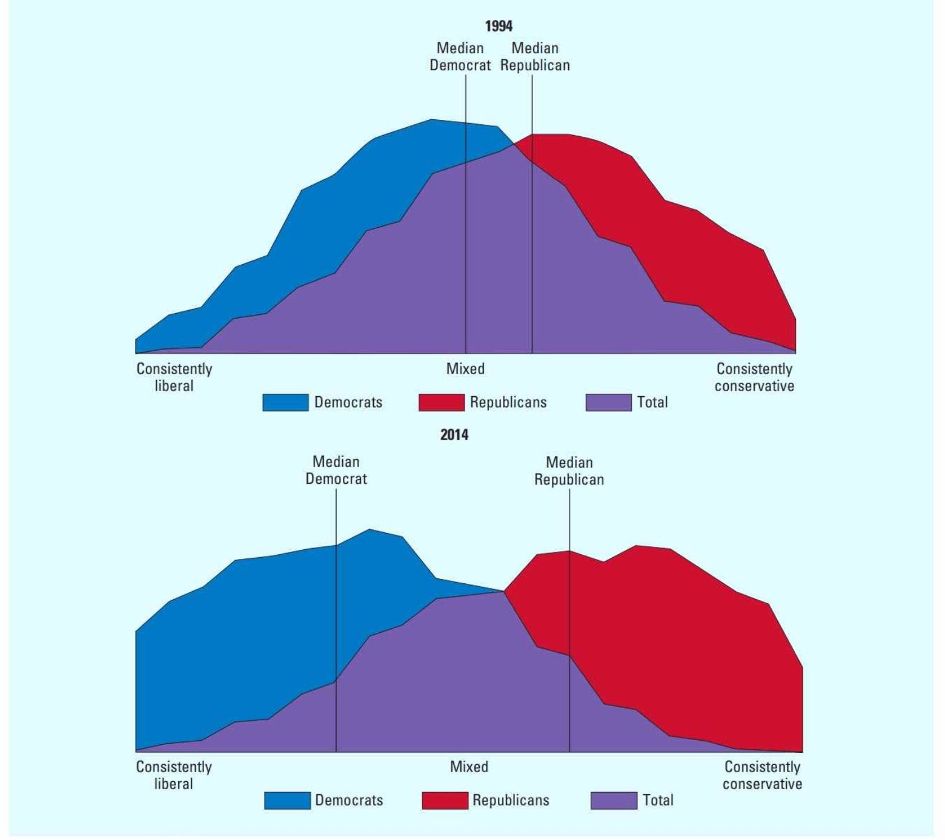
Explaining Voting Choice
Voting can always be “irrational” (recall “bounded rationality”).
  Party identification > Candidates’ attributes > Issues and policies
Campaign Effects
  The television campaign
    Television news is not enough.
    TV shows, advertisements, and social media
    can help better influence voters.
  The presidential debates
    1960, JFK v Nixon – the first debate
    1987, Commission on Presidential Debates
    Relatively low influence in votes, but
    sometimes it can play a role (Biden v Trump)
  The election strategy
    Technical influence (e.g. personal contact,
    the candidate’s persuasion in person, …)

Slide 12
Campaigns, Elections, and Democracy
Majoritarianism – incompatible
  Recall: the Model of Responsible Party Government
    American parties formulate their platforms and pursue their announced policies.
    But… candidates and voters are not well connected through campaigns & elections.
  In nominating presidential candidates, party principles matter; but Congress members nominations count rarely on the party platform.
  Both parties may be “responsible” for their own constituents, but not respond to the rest of voters, who are ideologically more moderate.
Pluralism – more compatible
  Two parties are like two giant interest groups (if not two religions)
  Stronger parties may strengthen democratic government (like a strong interest group), but there are differences with interest groups – under a divided government, strong parties may lead to gridlocks.
  The decentralized nature of campaigns & elections offer opportunities for interest groups to exert their influence, but can frustrate majority interests on occasion.

Slide 13
Next week…
Remember that we have our last class on Dec 2nd, a Tuesday with the Friday schedule.
We have covered all of the substantive materials (maybe some were overlooked, but you can go through by yourselves at any time you like.)
Next time: take-aways sharing, final review, parting thoughts, (and course evaluation)
Wish you a happy Thanksgiving Week!

